Slide 1
The Effect of Spending Cuts on Teenage Pregnancy
Liam Wright
Department of Epidemiology and Public Health
University College London
Co-author: Professor David Paton, University of Nottingham

Slide 2
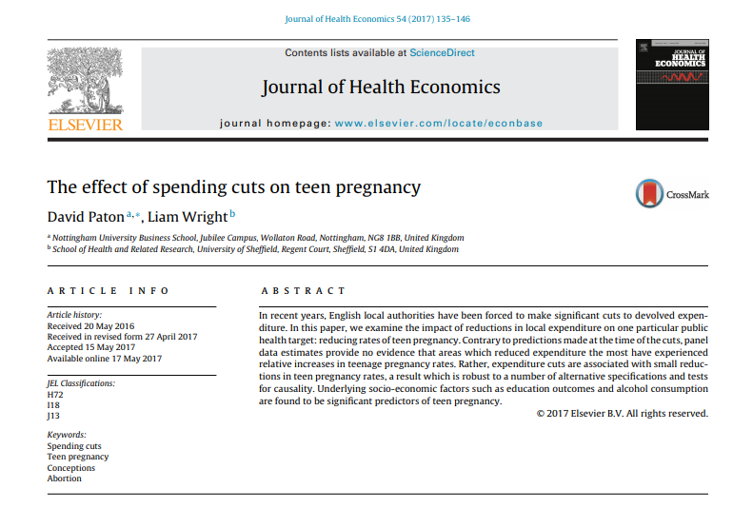

Slide 3
Outline
Background
Why Tackle Teenage Pregnancy?
The Teenage Pregnancy Strategy
Post-Strategy Outlook
Economics of Teen Pregnancy
Previous Evaluations and Related Evidence
Journal of Health Economics Paper
Research Questions
Data
Methods
Results
Discussion
Media Response

Slide 4
Why Tackle Teenage Pregnancy? (I)
Around 40% of pregnancies to 16-19 year olds are unplanned (Wellings et al., 2013). Half of pregnancies to under-18s end in abortion (ONS, 2018).
Young mothers have higher levels of pre- and perinatal depression (Lanzi et al., 2009)
Young fathers more likely to be unemployed and to be separated from child’s mother at age 30 (Berrington et al., 2005b)
Children of teenage parents have:
Worse behavioural adjustment and lower school readiness at age 3 (Golding et al., 2001; Hawkes, 2010)
Worse spatial, non-verbal and verbal ability at age 5 (Morinis et al., 2013)
Higher likelihood of repeat care and involvement in serious case review (Broadhurst et al., 2015; Department for Education, 2012)
HOWEVER: Question of causality remains
Effects may be due to social circumstances, rather than age itself (Berrington et al., 2005a)
Also question of whether other, uncontrolled for differences behind associations
Relationship with schizophrenia and maternal age partly explained genetically (Mehta et al., 2016)

Slide 5
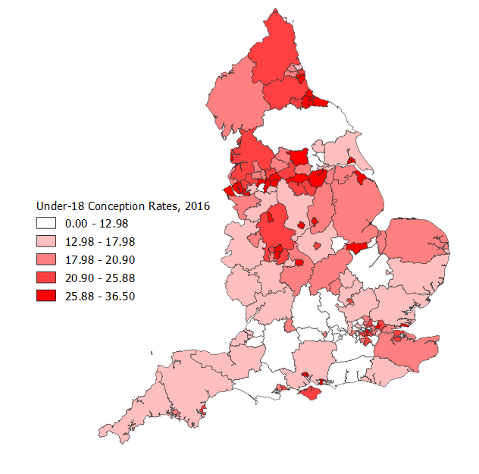
Why Tackle Teenage Pregnancy? (II)
Data: ONS (2018)

Slide 6
Why Tackle Teenage Pregnancy? (III)
Data: PHE (2018)

Slide 7
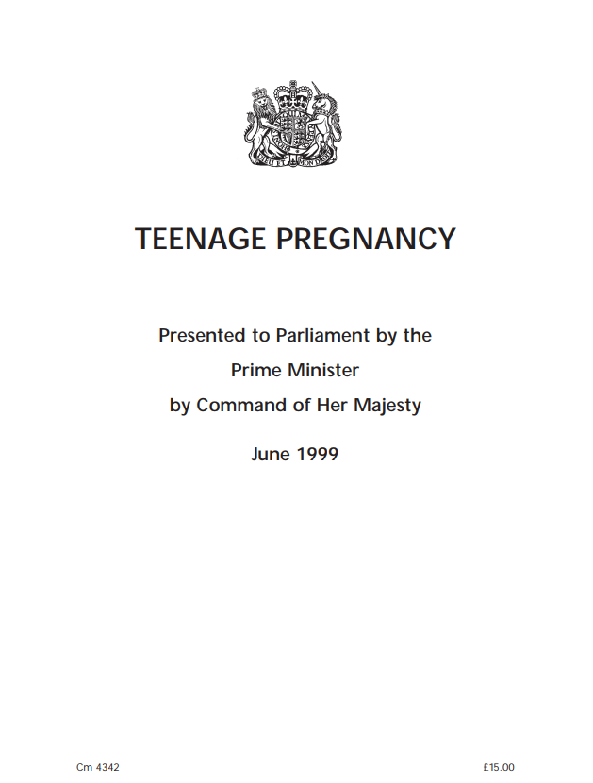
The Teenage Pregnancy Strategy (I)
Social Exclusion Unit (1999)

Slide 8
The Teenage Pregnancy Strategy (II)
Data: World Bank (2018)

Slide 9
The Teenage Pregnancy Strategy (III)
Goals to be achieved by 2010:
Reduction in under-18 conception rate by 50% overall;
Setting of under-16 on a downward trend; and
Participation of teenage parents in employment, education or training of 60%
National Media Campaign and Local Strategies
Local strategies developed with guidance and final approval from central Teenage Pregnancy Unit (TPU) and regional Teenage Pregnancy Coordinators.
Local strategies supported via Local Implementation Grants (LIGs)
£150k - £600k per local authority per annum (~£27.5m per year overall)
Initially ring-fenced, to be used for employing teenage pregnancy coordinators, setting up partnership boards, and starting new initiatives or extending existing schemes.
Cross-departmental ‘whole systems’ approach with boards involving stakeholders from education, Connexions, health, housing, social services and the voluntary sector.

Slide 10

The Teenage Pregnancy Strategy (IV)
Local authorities exercised considerable discretion in initiatives undertaken with variation across local authorities and time.
Local strategies focused on:
Opening and publicising young person family planning services and enabling greater access to contraception
Expanding sex and relationships education in schools and social services
Targeted interventions for at-risk youths.
Improved pathways across local services.
Data: David Paton (2013)
Notes:
Mention removal of ring-fencing.

Slide 11
The Teenage Pregnancy Strategy (V)
Central TPU and regional coordinators axed in 2010, but guidance continued to be published (e.g., Department for Children, Schools and Families and Department of Health, 2010).
Targets not renewed, but under-18 conceptions part of Public Health England’s ‘Public Health Outcomes Framework’.
Funding for Teenage Pregnancy Services subsumed within ‘Early Intervention Grant’.
Early Intervention Grant cut 14.3% between 2010/11 and 2011/12.
One third of local coordinators cut in 2011 (Williams, 2011).
Data: Various

Slide 12
Post-Strategy Outlook (I)
Data: ONS (2018)

Slide 13
Post-Strategy Outlook (III)
Data: ONS (2018)

Slide 14
Post-Strategy Outlook (IV)
Data: PHE (2018)

Slide 15
Post-Strategy Outlook (V)
Data: ONS (2018)

Slide 16
Post-Strategy Outlook (VI)
Data: ONS (2018)

Slide 17
Evidence Base (I)
Data: ONS (2018)

Slide 18
Evidence Base (II)
Data: ONS (2018); NHS (2017)

Slide 19
Evidence Base (III)
Data: Natsal-2 (2005); Natsal-3 (2017)

Slide 20
Evidence Base (IV)
Data: ONS (2018); Census 2001; Census 2011
Notes:
MENTION OTHER TRENDS – FIRST TIME ENTRANTS TO YOUTH JUSTICE SYSTEM, LEAD IN ATMOSPHERE, PARTICIPATION IN EET.

Slide 21
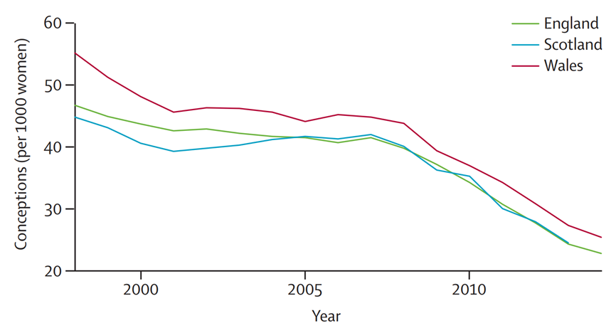
Evidence Base (V)
Figure: Craig et al. (2016)

Slide 22
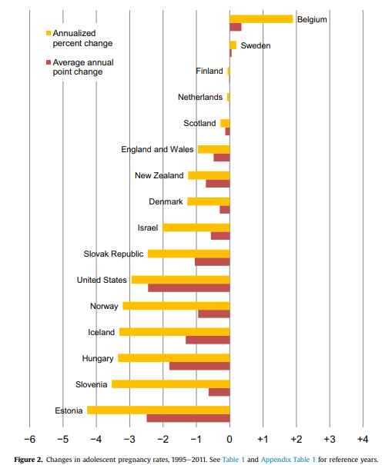
Evidence Base (VI)
Figure: Sedgh et al. (2015)

Slide 23
Economics of Teen Pregnancy (I)
Economists have long argued that access to contraceptives or expanding SRE has an a priori ambiguous impact on pregnancy rates (e.g., Akerlof et al., 1996; Oettinger, 1999; Paton, 2002).
Common behind these arguments is the idea of ‘Risk Compensation’
Contraception and sex education, by lowering (perceived or actual) risk of pregnancy following intercourse, increase incentives to engage in sexual activity.
Risk Compensation observed across multiple areas such as transport, sport and implied in drug policy.
Bill Booth’s Rule #2: “the safer skydiving gear becomes, the more chances skydivers will take, in order to keep the fatality rate constant.”
To be a plausible explanation, two conditions must be met:
Young people must respond to incentives
Difference in contraceptive ‘failure’ rates must be reasonably small.
$$Pregnancy Risk=Failure Rate ∙\# Sexual Episodes$$

Slide 24
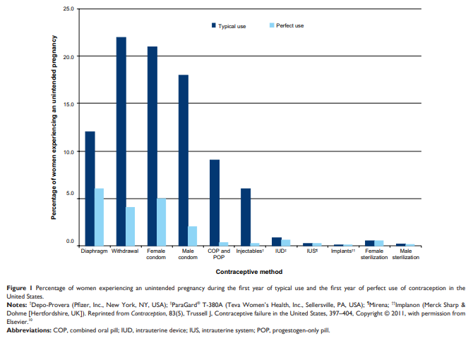
Economics of Teen Pregnancy (II)
Young People and Incentives:
Evidence that expansion of ‘non-barrier’ contraceptives is associated with reduced condom use (Steiner et al., 2016) and with increased incidence of STIs (Girma and Paton, 2011; Mulligan, 2016). Evidence that restriction in abortion is associated with lower incidence of gonorrhoea (Klick and Stratmann, 2008).
2. Contraceptive Failure Rates:
US data shows failure rates over 10% for condom, diaphragm and withdrawal (Trussell, 2011).
Some (inconsistent) evidence that failure rates are higher amongst young people (Kost et al., 2008).
Figure: Connolly et al. (2014)

Slide 25
Economics of Teen Pregnancy (III)
Data: Natsal-3 (2017)
Notes:
MENTION EVIDENCE THAT LARCS AREN’T GIVEN AS FREQUENTLY TO THOSE WHO HAVEN’T BEEN PREGNANCY BEFORE (80% OF PREGNANCIES) AND STILL OPEN QUESTION OF WHO GETS THEM! % OVERALL? WHAT AGE GROUP IS THIS.

Slide 26
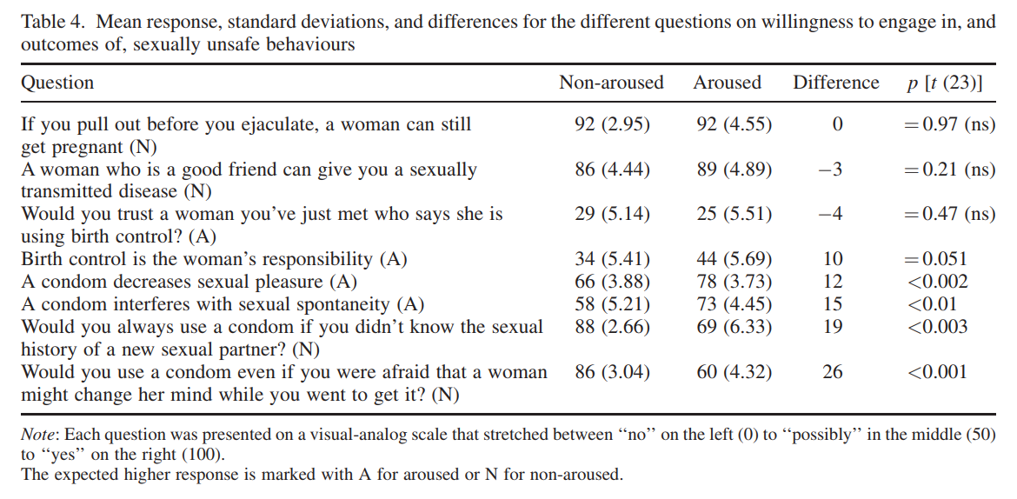
(Behavioural) Economics of Teen Pregnancy
Figure: Ariely and Loewenstein (2006)

Slide 27
Previous Evaluations: Wilkinson et al. (2006)
Analysis of local-authority level data.
Adjusting for baseline conception rate, LIG significantly associated with decline in conceptions between 1994/98 and 1999/2003.
However:
LIG unrelated to changes in abortion rates and other controls only region and deprivation.
Decline in conception rates not consistently related to quality of SRE, media, and level of coordination.
Decline slowest in areas with greatest access to services (though authors note, this may be confounded by baseline access).

Slide 28
Previous Evaluations: French et al. (2007)
Analysis of surveys giving to young people (13-21) across 2000 to 2004 about aspects of the Teenage Pregnancy Strategy.
Significant increase in men’s knowledge that contraceptives available free of charge and in both genders knowledge that people of any age can get free condoms.
Slight increase in service use by women (65.1% vs 63.1%), but not by men or amongst sexually active. Larger change substitution across services.
LIG expenditure not associated with contraceptive service use. Local TPU effort associated with service use in men but not women. No association between use and distance from any sexual health service.
However, authors note, two-thirds of services only open once a week!
Notes:
90% of sexually active young women report using contraceptive service in last year, which suggests small scope for improvement.

Slide 29
Previous Evaluations: DfES (2006)
‘Deep-dive’ comparing three high-performing local authorities with three low-performing ‘statistical neighbours’.
Unlike low-performing areas, high-performing areas had:
Engagement with senior staff and cross-service involvement (e.g. health, education, youth services), with
Staff SRE training in partner agencies (particularly youth service)
Commitment to SRE in schools
Youth-oriented sexual health services
Targeting of at risk youth (e.g. looked after children)
However:
Methods not detailed, so unable to evaluate study quality (Blackman, 2013).

Slide 30
Previous Evaluations: Blackman (2013)
Qualitative Comparative Analysis of data from 27 of 70 ‘Spearhead’ local authorities.
Identifies baseline factors related to narrowing or not of gap from national under-18 conception rate between 2005 and 2009.
Finds “dedicated planning to tackle high teenage conception rates appears to make things worse” (p.69).
However:
Unclear whether commissioning standard changed over period.
Commissioning may divert resources from other activities. Doesn’t imply activities themselves are counter-productive.
Potentially biased sample.

Slide 31
Previous Evaluations: Wellings et al. (2016)
Analysis of local authority data and comparison of Natsal 2000 & 2010
£100 per head LIG related to fall in average conception rate of 8.2 4.1 between 1994/98 and 2009/13. Equal to around 59% of overall decline and 18% fall overall.
However, LIGs largely determined by baseline conception rates.
Natsal 2010 vs 2000:
38% vs 9% learn about sex in school. School associated with 29% lower odds of early pregnancy than case where parents are main source.
However, no significant differences in use of reliable contraception at first intercourse (11% vs 12%); similar numbers having sex before age 16 (24% vs 29%) and reporting not needing more information at first sex (24% vs 28%).
Relationship between risk factors and risk of under-18 pregnancy is similar across surveys.
Results not linked with LIG spending (may be secular changes)

Slide 32
Related Evidence (I)
English over-the-counter emergency contraception schemes not related to lower teen pregnancy rates (Girma and Paton, 2006; Girma and Paton, 2011).
LARCs uptake correlated with teenage pregnancy rates at country but not local level (Connolly et al., 2014). LARC promotion – defined as % of family planning attendees prescribed LARCs – has inconsistent and small relation with teenage pregnancy rates at local level (Girma and Paton, 2015).
Participation in Young People’s Development Programme, an intervention including some SRE delivered to at-risk youth, related to increased teen pregnancy rates (Wiggins et al., 2009).
RCTs of RIPPLE and SHARE, two SRE schemes, find no evidence of change in teen pregnancies (Wight, 2011).

Slide 33
Related Evidence (II)
A recent Cochrane review found no evidence that SRE programmes reduced pregnancy rates (Mason-Jones et al., 2016).
In United States, 86-100% of recent decline in teen birth rates explained by better contraceptive use (Santelli et al., 2007; Lindberg et al., 2016). Yet, Kearney and Levine (2015) find only 12.6% of decline in US birth rate due to expanded access to family planning services through Medicaid.
HOWEVER:
RCTs may be underpowered given rarity of teenage pregnancy.
Control intervention frequently less intensive form of SRE.
Cochrane review uses evidence from across globe, so results may not generalize.
Observational studies more frequently find school-based SRE reduces teenage pregnancy rates (e.g. Macdowell et al., 2013).
Another Cochrane review found SRE or contraceptive promotion alone do not reduce unintended pregnancy rates, but do when provided in combination (Oringanje et al., 2016).

Slide 34
Research Questions
Did local authorities which cut Teenage Pregnancy Strategy-related expenditure the most observed slower declines in under-18 conception rates relative to those that cut expenditure less quickly?
Are the same associations found for abortion rates and birth rates, separately?

Slide 35
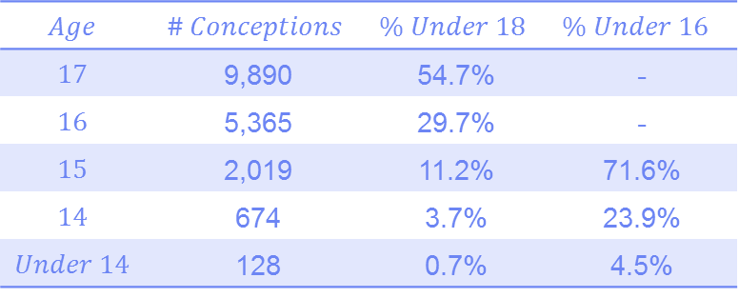
Data: Outcomes
Under-18 and Under-16 Conception, Abortion and Birth Rates, 2009-2014.
Provided by the ONS for 149 Upper-Tier Local Authorities (Metropolitan Boroughs and Unitary Authorities).
Per 1,000 15-17 year old and 13-15 old female residents, respectively.
Conception rates are the sum of pregnancies ending in abortion, live birth or still birth
Miscarriages not included and assumed to be unrelated to TPS spending.
This may be implausible: Rai and Regan (2006) note miscarriage related to psychological distress.
Other components likely to be accurate.
$$Age$$ | $$\# Conceptions$$ | $$\% Under 18$$ | $$\% Under 16$$
$$17$$ | 9,890 | 54.7% | -
$$16$$ | 5,365 | 29.7% | -
$$15$$ | 2,019 | 11.2% | 71.6%
$$14$$ | 674 | 3.7% | 23.9%
$$Under 14$$ | 128 | 0.7% | 4.5%
Source: 2016 Conception Statistics, England and Wales
Notes:
Note prevalence of miscarriage – not a small issue.

Slide 36
Data: Exposure
Teenage Pregnancy Service-Related Expenditure, 2008/09 – 2013/14.
Per resident female aged 13-17, deflated to 2014 prices using the Consumer Price Index.
Taken from the Department for Education (DfE) Section 251 Outturn Data Series
From guidance to local authorities: “8a.2 Teenage pregnancy services (included in 3.5.1 and 3.5.2 above): Include here all expenditure wholly focused on implementing and coordinating local teenage pregnancy strategies to reduce under 18 conceptions and to improve outcomes for teenage parents and their children reflecting the DfE planning guidance. Exclude spending on activities funded by the Public Health Grant and reported through the Public Health Grant return.”
Therefore, does not capture all spending aimed at reducing teenage pregnancy rate:
Some expenditure combined with mainstream funding may not be included. Spending by other parties or existing expenditures may not be included.
Includes multiple £0 returns, which may be erroneous.

Slide 37
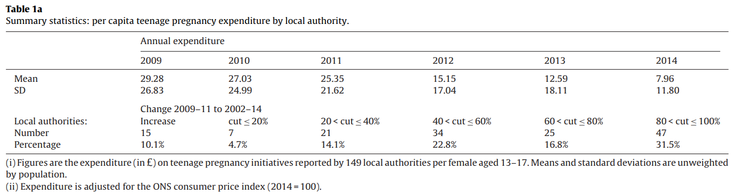
Data: Exposure

Slide 38
Data: Control Variables
Other LA Spending:
Exp young: LA expenditure on children-related services (per 1,000 residents aged 13-17)
Exp alcohol: LA expenditure on alcohol and drug prevention services (per 1,000 residents aged 13-17)
GCSE: Three-year average % of final-year pupils gaining 5 A*-C GCSEs
Workless: % children resident in households with no adult in employment
Fem Unem: % women aged 16-24 claiming joblessness related benefits
Non White: % secondary pupils classified as non-white
Care: children in local authority care (per 1,000 resident children)
Alcohol: under-18 alcohol-specific condition hospital admissions (per 100,000 population)
Political Control: Dummy variables for each of Labour, Conservative and Lib Dem council control.
DOES NOT INCLUDE: Media consumption patterns, drug use, expected wages, refined data on those most at risk of pregnancy.

Slide 39
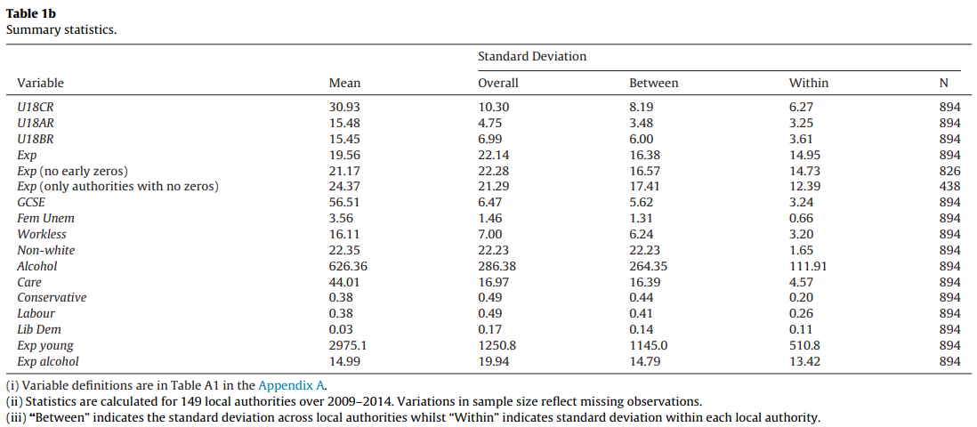
Data: Descriptive Statistics

Slide 40
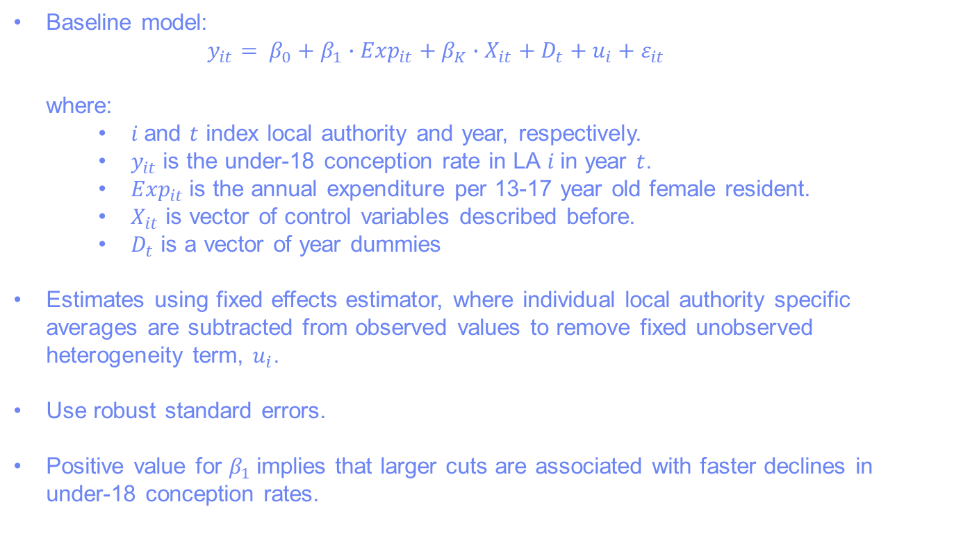
Methods
Baseline model:
$$y_{it}= β_{0}+β_{1}∙{Exp}_{it}+β_{K}{∙X}_{it}+ D_{t}+u_{i}+ε_{it}$$
where:
$i$ and $t$ index local authority and year, respectively.
$y_{it}$ is the under-18 conception rate in LA $i$ in year $t$.
${Exp}_{it}$ is the annual expenditure per 13-17 year old female resident.
$X_{it}$ is vector of control variables described before.
$D_{t}$ is a vector of year dummies
Estimates using fixed effects estimator, where individual local authority specific averages are subtracted from observed values to remove fixed unobserved heterogeneity term, $u_{i}$.
Use robust standard errors.
Positive value for $β_{1}$implies that larger cuts are associated with faster declines in under-18 conception rates.

Slide 41
Issues (I)
Policy Endogeneity:
Fixed effects does not solve time-varying confounding issues. Association between expenditure and conception rates may be driven by other, unobserved factors.
These factors may include: previous changes/trends in conception rates; external pressures on council budgets; political party in control.
Cross-Border Movements
Services may be consumed by young people from neighboring authorities. Incentive to cut services where high quality services exist nearby.
True expenditure on residents may be biased and related to teenage pregnancy rates.

Slide 42
Issues (II)
(Potential) Measurement Error in Expenditure Data
£0 figures may be incorrect and related to existing conception rates lead to spurious association.
Other funding sources in local authority may expand as cuts are made elsewhere.
Young people may substitute from one service to another (supported by evidence in French et al., 2007), other services may open or taken over by other funding sources.
Note, this problem can’t be solved with our available data.

Slide 43
Robustness Checks (I)
Comparison rates for over-24s: assumption that confounding should effect both groups.
Interaction between expenditure and top 50% decrease from 1999-2008: assumption that best performing LAs may cut fastest which could bias results.
Instrumental Variables with total expenditure, previous changes in conception rates and over-65 population as instruments: assumption these are exogenous pressures on cutting Teenage Pregnancy Services.
Inclusion of lagged conception rates: assumption that already achieved drops in conception rates will increase likelihood of cuts.

Slide 44
Robustness Checks (II)
Inclusion of lag and lead expenditure: assumption that if expenditure (reverse) related to conception rates, expenditure at t+1 should be related to outcomes.
Exclusion of authorities with £0 expenditure figures: assumption these most likely to be spurious figures
Re-apportioning expenditure for pupil movements across authority boundaries: assumption that spending related to school location rather than residence.

Slide 45
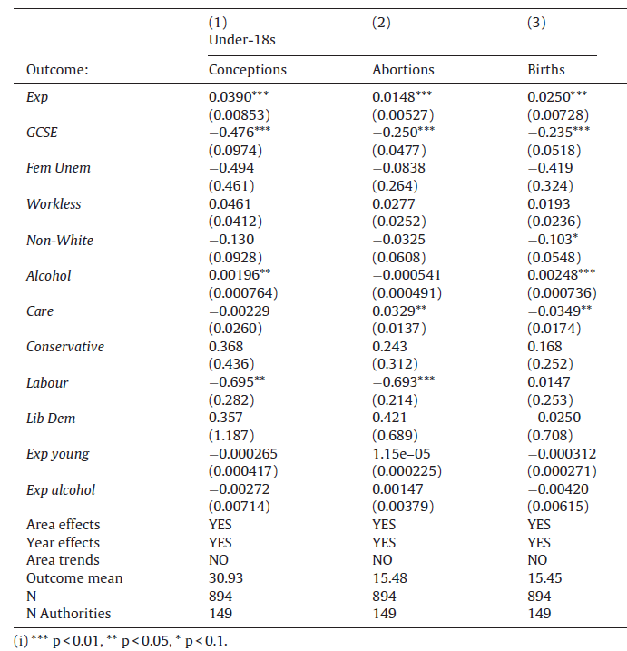
Results: Baseline

Slide 46
Results: Baseline
Small: 10% cut equal to 0.25% increase in conception rate.

Slide 47
Results: Baseline
Large: 10% rise equal to 10% decrease in conception rate.

Slide 48
Results: Robustness Checks
Main effects remain significant at 10% level or above in all robustness checks. Coefficients are reduced or larger in size, though effects continue to be small.
Effects of expenditure are not significantly greater for those with largest conception rate decreases between 1999-2008 or with funding non-ring-fenced earlier.
Findings are robust to including area or regional time trends, to included lagged conception rates and to including lag and lead expenditure variables.
Latter two tests suggest reverse causality (conception rates determining expenditure) does not explain association.
Expenditure remains positively associated with expenditure restricting sample to those with non-zero expenditure and when re-allocating expenditure according to pupil flows across local authority boundaries.

Slide 49
Summary (I)
We find consistent evidence that cuts to Teenage Pregnancy Related Services is associated with faster declines in under-18 conception, abortion and birth rates. Similar results (though not always significant) are found for under-16 rates.
Effects are small: 10% cut equal to 0.25% increase in conception rate (baseline model).
Results are robust to several alternative specifications. In none of our estimates are cuts related to increases in conception rates.
Increasing GCSE attainment and (to lesser extent) declining alcohol-specific hospitalisations are associated with declining conception rates.

Slide 50
Summary (II)
Our results are not consistent with those from Wilkinson et al. (2006) and Wellings et al. (2016), who find LIG related to declines in conception rates.
Our results are more consistent with French et al. (2007), Blackman (2013), and some results from Wilkinson et al. (2006), which suggest TPS-related effort appears to be unproductive or counter-productive.
Possible explanations for our results include:
Greater impact of socio-economic determinants for pregnancy;
“Teenage pregnancy is probably the outcome least susceptible to school sex education, given that rates are shaped by poverty, educational aspirations and local views towards child bearing” (Wight, 2011, p.72)
Changing sexual behaviour;
Substitution across services;
Diversion of resources to coordination rather than services; and
Confounding processes

Slide 51
Limitations
Ecological study
Unobserved confounding and policy endogeneity may persist, with robustness checks not solving these issues.
Limited significance of control variables may signify poor model fit.
Only look at marginal effects from a specific funding source
Data does not allow us to distinguish between different types of programme and does not include National Campaign spending.
Least effective programmes may be cut first. More effective programmes may be moved over to mainstream funding (Hadley, 2017).
More intensive spending could have opposite effect
May have been substitution between services and we don’t test effect of cuts to more general services.
Short-term outcomes only.
TPS interventions not just delivered to 13-17 year olds (e.g. SRE). Negative effects may be seen in the long run.
However, Arcidiano et al. (2012) find evidence contraceptive access may have worse effects in long-run than short-run.

Slide 52
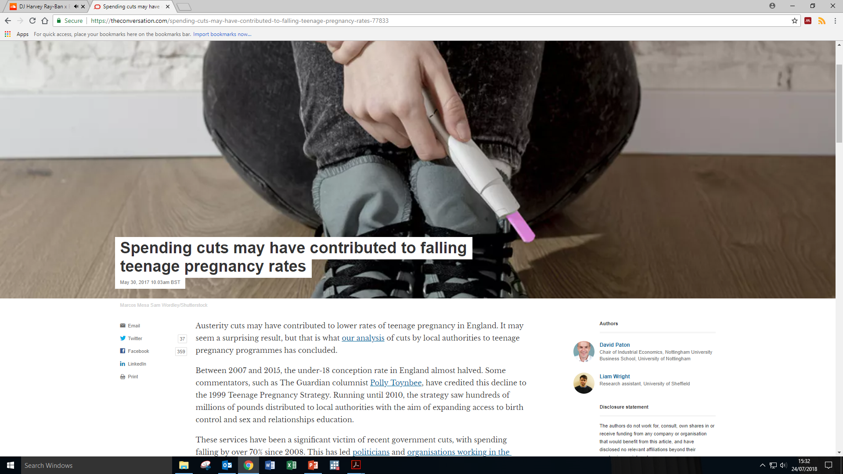
Media Response (I)

Slide 53
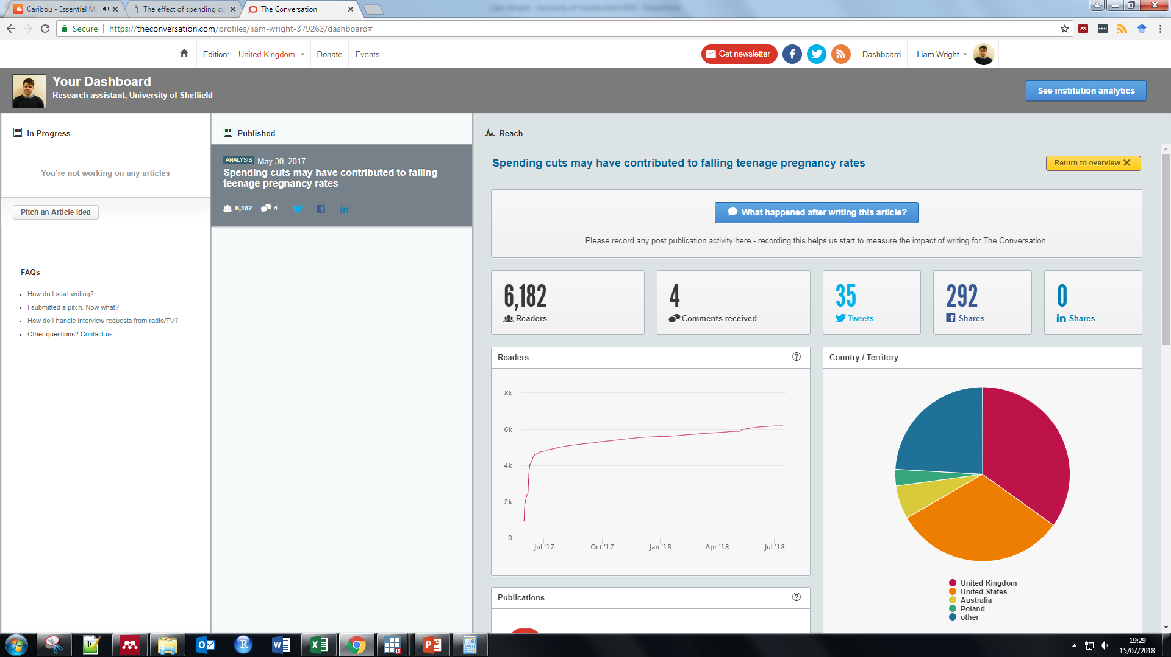
Media Response (II)

Slide 54
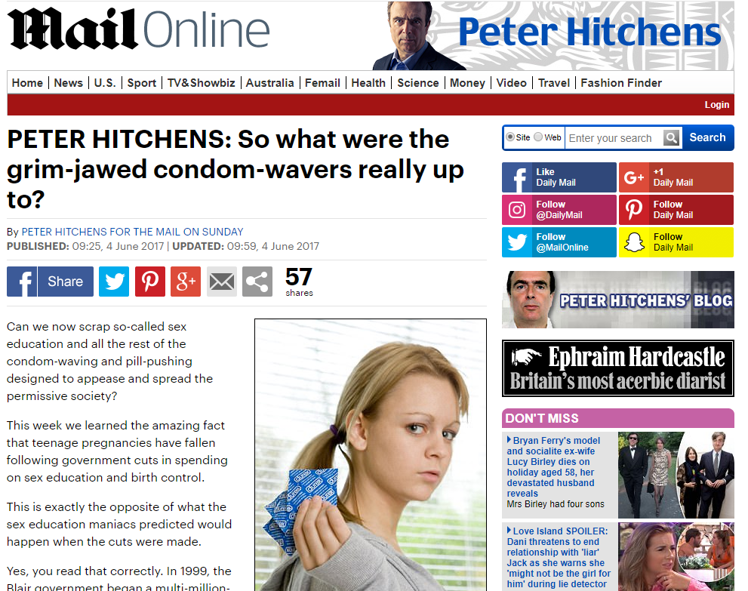
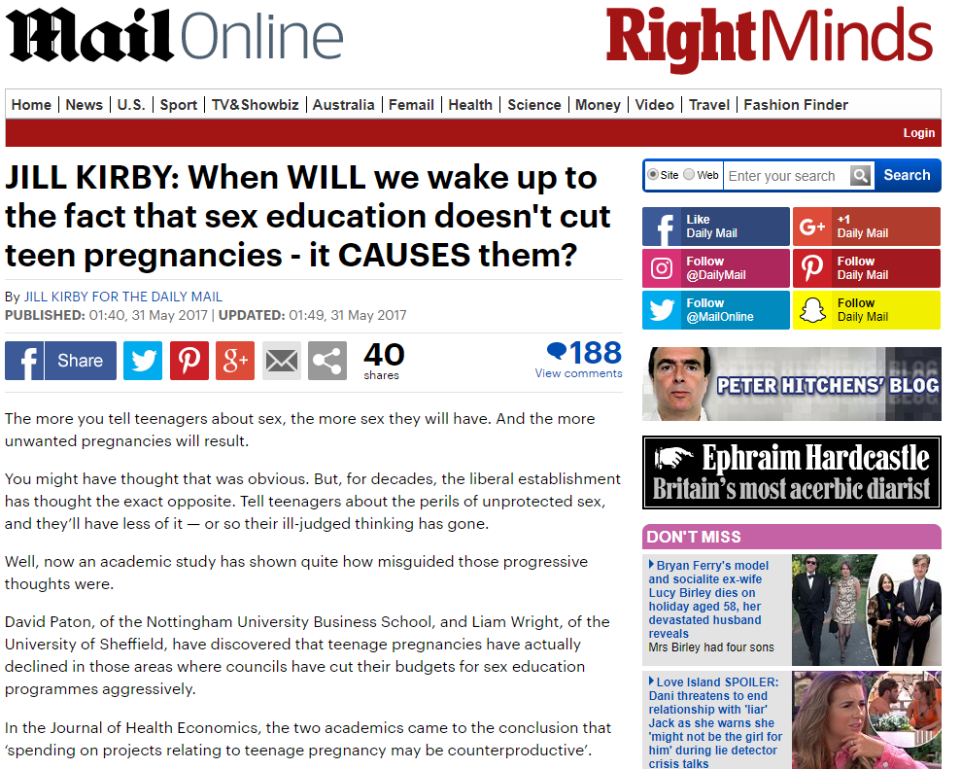
Media Response (III)
Notes:
Mention no right of reply and also what they said. Also mention the response from people on the other side of the debate. Note that no one talks about the increase in GCSE attainment. Speed of news cycle. Woman who emailed.

Slide 55
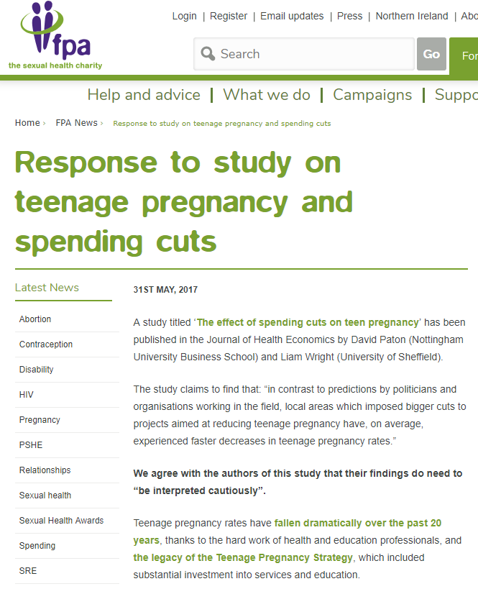
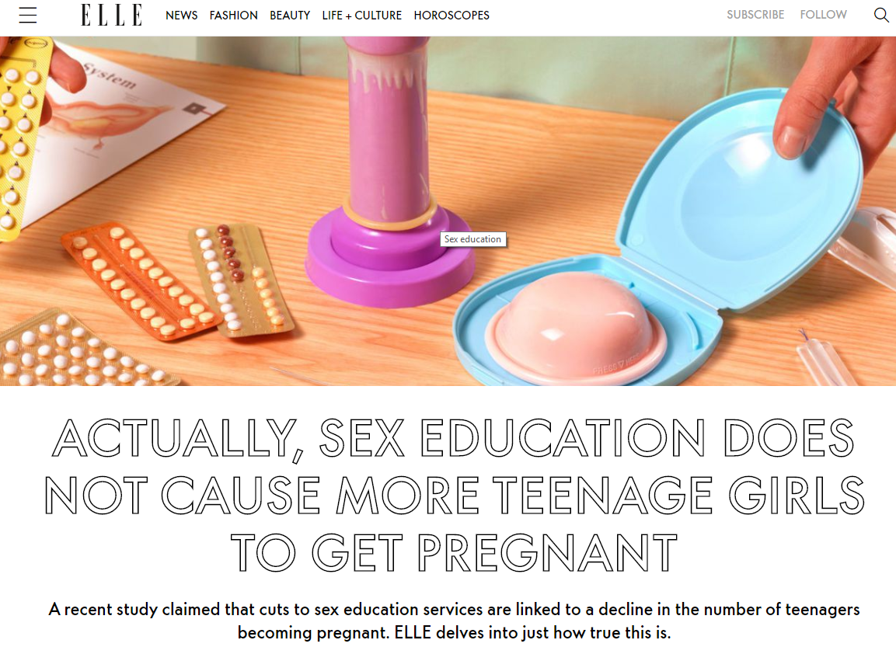
Media Response (IV)

Slide 56
Thank you
Questions?
Email: liam.wright.17@ucl.ac.uk
Twitter: @LWSocialEpi

Slide 57
References (I)
Akerlof, G. A., Yellen, J. L., & Katz, M. L. (1996). An Analysis of Out-of-Wedlock Childbearing in the United States. The Quarterly Journal of Economics, 111(2), 277–317. http://doi.org/10.2307/2946680
Arcidiacono, P., Khwaja, A., & Ouyang, L. (2012). Habit persistence and teen sex: Could increased access to contraception have unintended consequences for teen pregnancies? Journal of Business and Economic Statistics, 30(2), 312–325. http://doi.org/10.1080/07350015.2011.652052
Ariely, D., & Loewenstein, G. (2006). The heat of the moment: The effect of sexual arousal on sexual decision making. Journal of Behavioral Decision Making, 19(2), 87–98. http://doi.org/10.1002/bdm.501
Blackman, T. (2013). Exploring explanations for local reductions in teenage pregnancy rates in England: An approach using qualitative comparative analysis. Social Policy and Society, 12(1), 61–72. http://doi.org/10.1017/S1474746412000358
Connolly, A., Pietri, G., Yu, J., & Humphreys, S. (2014). Association between long-acting reversible contraceptive use, teenage pregnancy, and abortion rates in England. International Journal of Women’s Health, 6, 961–974. http://doi.org/10.2147/IJWH.S64431
Connolly, A., Pietri, G., Yu, J., & Humphreys, S. (2014). Association between long-acting reversible contraceptive use, teenage pregnancy, and abortion rates in England. International Journal of Women’s Health, 6, 961–974. http://doi.org/10.2147/IJWH.S64431
Craig, P., Dundas, R., Leyland, A., & Popham, F. (2016). How successful was the English teenage pregnancy strategy? The Lancet, 388(10060), 2604. http://doi.org/10.1016/S0140-6736(16)32223-1
Department for Education and Skills (2006). Teenage Pregnancy Strategy Next Steps. Available from: http://lx.iriss.org.uk/sites/default/files/resources/Teenage%20pregnancy%20next%20steps.pdf
French, R. S., Mercer, C. H., Kane, R., Kingori, P., Stephenson, J. M., Wilkinson, P., … Wellings, K. (2007). What Impact Has England’s Teenage Pregnancy Strategy Had on Young People’s Knowledge of and Access to Contraceptive Services? Journal of Adolescent Health, 41(6), 594–601. http://doi.org/10.1016/j.jadohealth.2007.06.006
Girma, S., & Paton, D. (2006). Matching estimates of the impact of over-the-counter emergency birth control on teenage pregnancy. Health Economics, 15(9), 1021–1032. http://doi.org/10.1002/hec.1129
Girma, S., & Paton, D. (2011). The impact of emergency birth control on teen pregnancy and STIs. Journal of Health Economics, 30(2), 373–380. http://doi.org/10.1016/j.jhealeco.2010.12.004
Girma, S., & Paton, D. (2015). Is education the best contraception: The case of teenage pregnancy in England? Social Science and Medicine, 131, 1–9. http://doi.org/10.1016/j.socscimed.2015.02.040
Hadley, A. (2017). Teenage Pregnancy and Young Parenthood: Effective Policy and Practice (1st ed.). Routledge.
Johnson, A., London School of Hygiene and Tropical Medicine. Centre for Sexual and Reproductive Health Research, NatCen Social Research, Mercer, C. (2017). National Survey of Sexual Attitudes and Lifestyles, 2010-2012. [data collection]. 2nd Edition. UK Data Service. SN: 7799, http://doi.org/10.5255/UKDA-SN-7799-2

Slide 58
References (II)
Kearney, M. S., & Levine, P. B. (2015). Investigating recent trends in the U.S. teen birth rate. Journal of Health Economics, 41, 15–29. http://doi.org/10.1016/j.jhealeco.2015.01.003
Klick, J., & Stratmann, T. (2008). Abortion access and risky sex among teens: Parental involvement laws and sexually transmitted diseases. Journal of Law, Economics, and Organization, 24(1), 2–21. http://doi.org/10.1093/jleo/ewm041
Kost, K., Singh, S., Vaughan, B., Trussell, J., & Bankole, A. (2008). Estimates of contraceptive failure from the 2002 National Survey of Family Growth. Contraception, 77(1), 10–21. http://doi.org/10.1016/j.contraception.2007.09.013
Lanzi, R. G., Bert, S. C., & Jacobs, B. K. (2009). Depression Among a Sample of First-Time Adolescent and Adult Mothers. Journal of Child and Adolescent Psychiatric Nursing, 22(4), 194–202. http://doi.org/10.1111/j.1744-6171.2009.00199.x
Lindberg, L., Santelli, J., & Desai, S. (2016). Understanding the Decline in Adolescent Fertility in the United States, 2007–2012. Journal of Adolescent Health, 59(5), 577–583. http://doi.org/10.1016/j.jadohealth.2016.06.024
Macdowall, W., Jones, K. G., Tanton, C., Clifton, S., Copas, A. J., Mercer, C. H., … Wellings, K. (2015). Associations between source of information about sex and sexual health outcomes in Britain: Findings from the third National Survey of Sexual Attitudes and Lifestyles (Natsal-3). BMJ Open, 5(3). http://doi.org/10.1136/bmjopen-2015-007837
Mason-Jones, A. J., Sinclair, D., Mathews, C., Kagee, A., Hillman, A., & Lombard, C. (2016). School-based interventions for preventing HIV, sexually transmitted infections, and pregnancy in adolescents. Cochrane Database of Systematic Reviews, 2016(11). http://doi.org/10.1002/14651858.CD006417.pub3
Mehta, D., Tropf, F. C., Gratten, J., Bakshi, A., Zhu, Z., Bacanu, S. A., … Lee, S. H. (2016). Evidence for genetic overlap between schizophrenia and age at first birth in women. JAMA Psychiatry, 73(5), 497–505. http://doi.org/10.1001/jamapsychiatry.2016.0129
Morinis, J., Carson, C., & Quigley, M. A. (2013). Effect of teenage motherhood on cognitive outcomes in children: A population-based cohort study. Archives of Disease in Childhood, 98(12), 959–964. http://doi.org/10.1136/archdischild-2012-302525
Mulligan, K. (2016). Access to Emergency Contraception and its Impact on Fertility and Sexual Behavior. Health Economics (United Kingdom), 25(4), 455–469. http://doi.org/10.1002/hec.3163
National Centre for Social Research, Johnson, A., Fenton, K., Copas, A., Mercer, C., McCadden, A., Carder, C., Ridgway, G., Wellings, K., Macdowall, W., Nanchahal, K. (2005). National Survey of Sexual Attitudes and Lifestyles, 2000-2001. [data collection]. UK Data Service. SN: 5223, http://doi.org/10.5255/UKDA-SN-5223-1
NHS (2017). Smoking, Drinking and Drug Use Among Young People in England - 2016. Available from: https://digital.nhs.uk/data-and-information/publications/statistical/smoking-drinking-and-drug-use-among-young-people-in-england/2016
Oettinger, G. S. (1999). The Effects of Sex Education on Teen Sexual Activity and Teen Pregnancy. Journal of Political Economy, 107(3), 606–644. http://doi.org/10.1086/250073

Slide 59
References (III)
ONS (2018). Conception statistics, England and Wales. Available from: https://www.ons.gov.uk/peoplepopulationandcommunity/birthsdeathsandmarriages/conceptionandfertilityrates/datasets/conceptionstatisticsenglandandwalesreferencetables
Oringanje, C., Meremikwu, M. M., Eko, H., Esu, E., Meremikwu, A., & Ehiri, J. E. (2016). Interventions for preventing unintended pregnancies among adolescents. Cochrane Database of Systematic Reviews. http://doi.org/10.1002/14651858.CD005215.pub3
Paton, D. (2002). The economics of family planning and underage conceptions. Journal of Health Economics, 21(2), 207–225. http://doi.org/10.1016/S0167-6296(01)00115-1
Paton, D., & Wright, L. (2017). The effect of spending cuts on teen pregnancy. Journal of Health Economics, 54, 135–146. http://doi.org/10.1016/j.jhealeco.2017.05.002
PHE (2018). Sexual and Reproductive Health Profiles. Available from: https://fingertips.phe.org.uk/profile/sexualhealth
Rai, R., & Regan, L. (2006). Recurrent miscarriage. Lancet, 368(9535), 601–611. http://doi.org/10.1016/S0140-6736(06)69204-0
Santelli, J. S., Lindberg, L. D., Finer, L. B., & Singh, S. (2007). Explaining recent declines in adolescent pregnancy in the United States: The contribution of abstinence and improved contraceptive use. American Journal of Public Health, 97(1), 150–156. http://doi.org/10.2105/AJPH.2006.089169
Sedgh, G., Finer, L. B., Bankole, A., Eilers, M. A., & Singh, S. (2015). Adolescent Pregnancy, Birth, and Abortion Rates Across Countries: Levels and Recent Trends. Journal of Adolescent Health, 56(2), 223–230. http://doi.org/10.1016/J.JADOHEALTH.2014.09.007
Social Exclusion Unit (1999) Teenage Pregnancy: report by the Social Exclusion Unit presented to Parliament by the Prime Minister by command of Her Majesty. Available from: http://dera.ioe.ac.uk/15086/
Steiner, R. J., Liddon, N., Swartzendruber, A. L., Rasberry, C. N., & Sales, J. M. (2016). Long-acting reversible contraception and condom use among female US high school students: Implications for sexually transmitted infection prevention. JAMA Pediatrics, 170(5), 428–434. http://doi.org/10.1001/jamapediatrics.2016.0007
Trussell, J. (2011). Contraceptive failure in the United States. Contraception, 83(5), 397–404. http://doi.org/10.1016/j.contraception.2011.01.021
Wellings, K., Jones, K. G., Mercer, C. H., Tanton, C., Clifton, S., Datta, J., … Johnson, A. M. (2013). The prevalence of unplanned pregnancy and associated factors in Britain: Findings from the third National Survey of Sexual Attitudes and Lifestyles (Natsal-3). The Lancet, 382(9907), 1807–1816. http://doi.org/10.1016/S0140-6736(13)62071-1
Wellings, K., Palmer, M. J., Geary, R. S., Gibson, L. J., Copas, A., Datta, J., … Wilkinson, P. (2016). Changes in conceptions in women younger than 18 years and the circumstances of young mothers in England in 2000–12: an observational study. The Lancet, 388(10044), 586–595. http://doi.org/10.1016/S0140-6736(16)30449-4
Wiggins, M., Bonell, C., Sawtell, M., Austerberry, H., Burchett, H., Allen, E., & Strange, V. (2009). Health outcomes of youth development programme in England: prospective matched comparison study. Bmj, 339(jul07 2), b2534–b2534. http://doi.org/10.1136/bmj.b2534

Slide 60
References (IV)
Wight, D. (2011). The effectiveness of school-based sex education: What do rigorous evaluations in Britain tell us? Education and Health 29(4),72-78. http://sheu.org.uk/sites/sheu.org.uk/files/imagepicker/1/294dw.pdf
Wilkinson, P., French, R., Kane, R., Lachowycz, K., Stephenson, J., Grundy, C., … Wellings, K. (2006). Teenage conceptions, abortions, and births in England, 1994-2003, and the national teenage pregnancy strategy. Lancet, 368(9550), 1879–1886. http://doi.org/10.1016/S0140-6736(06)69777-8
Williams, Rachel. (2011) Cuts threaten to do undo progress on reducing teenage pregnancies. The Gurdian. [Online] 9th August 2011. Available from: http://www.theguardian.com/society/2011/aug/09/cuts-undo-progress-teenage-pregnancies
World Bank (2018). Adolescent fertility rate. Available from: https://data.worldbank.org/indicator/SP.ADO.TFRT

